Slide 1
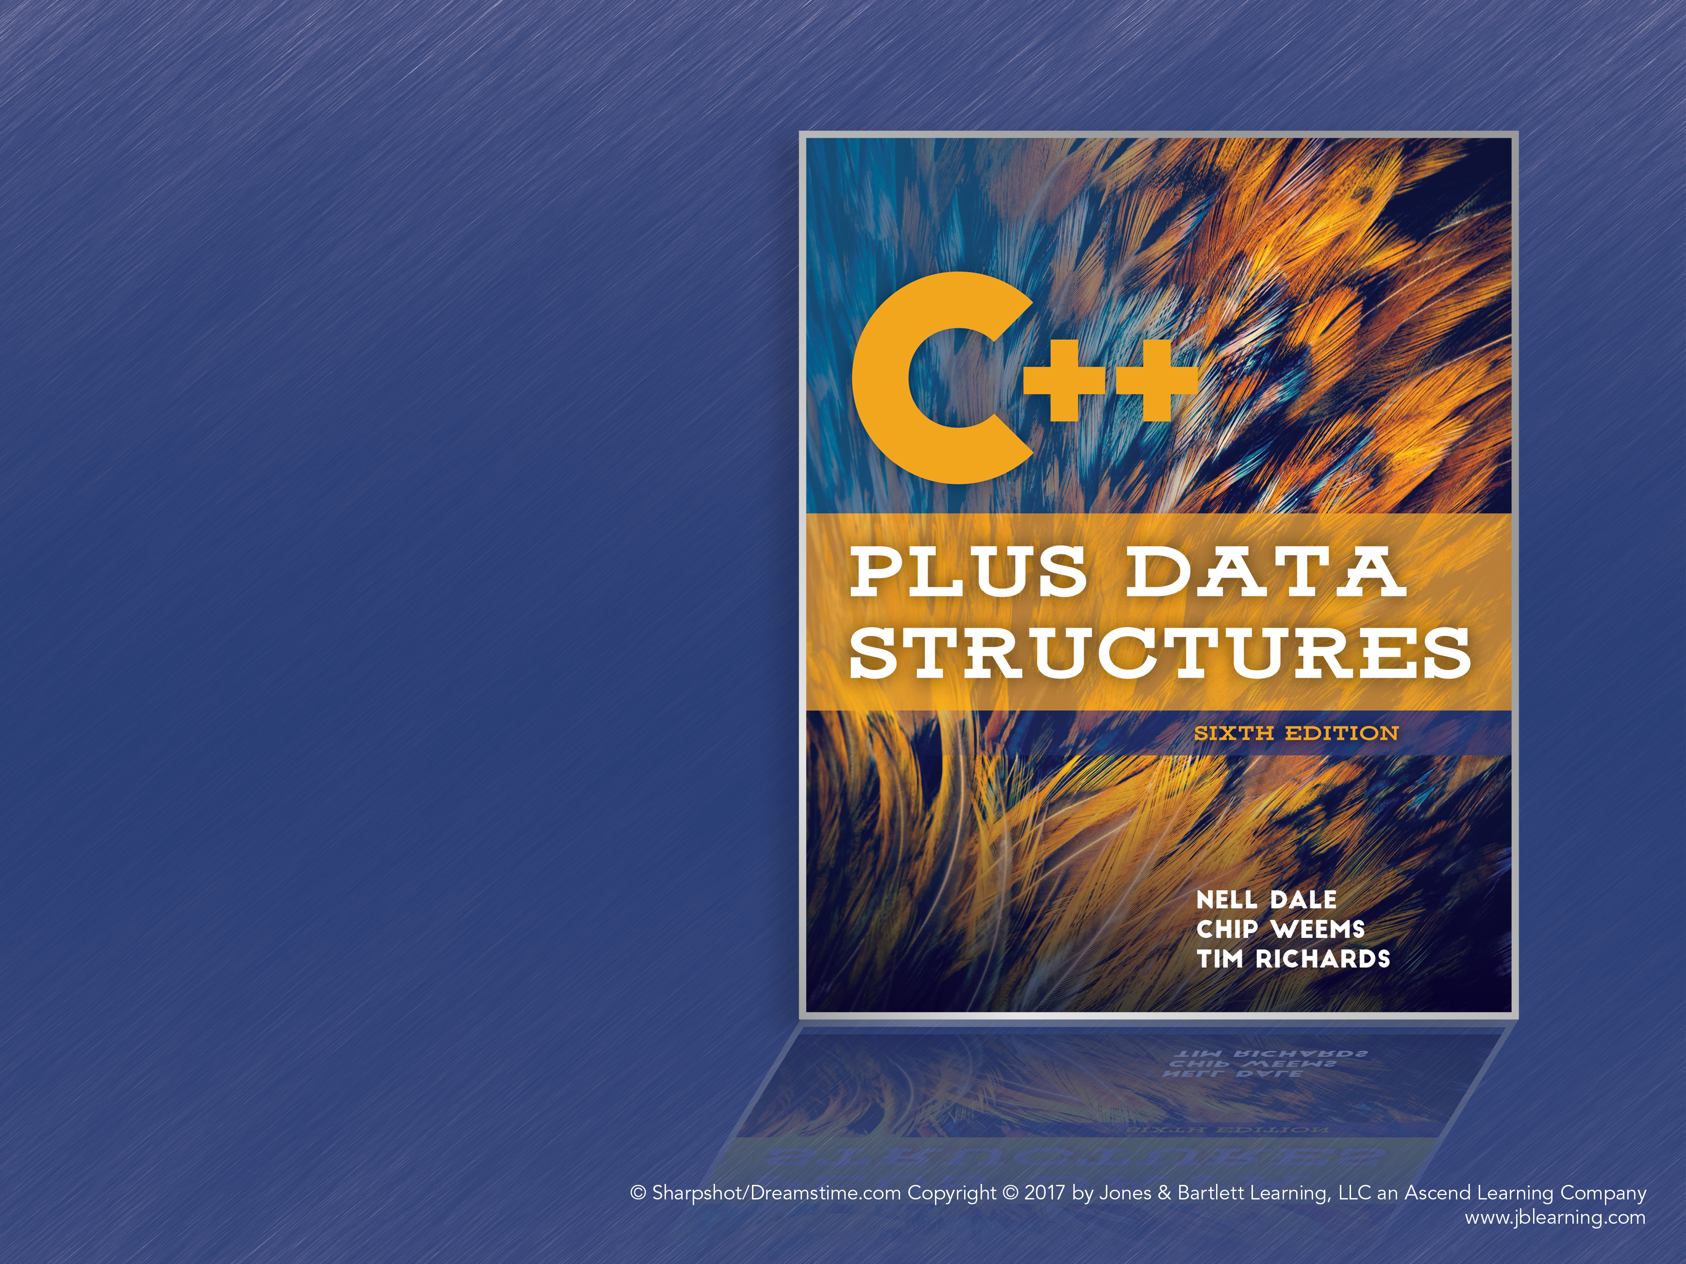
Chapter 3
ADT Unsorted List

Slide 2
Lists
A list is a homogeneous collection of elements with a linear relationship between elements
Linear Relationship: Each element except the first has a unique predecessor, and each element except the last has a unique successor
Length: The number of items in the list, which can vary over time

Slide 3
List Definitions
Unsorted List: A list in which data items are placed in no particular order
Sorted List: A list that is sorted by the keys of the list items; there is a semantic relationship among the keys of the items in the list
Key: The attributes used to determine the logical order of the list

Slide 4
Unsorted List: Operations
Constructor: May make empty list or take some initial elements
Transformers: PutItem, DeleteItem, MakeEmpty
Observers: IsFull, GetLength
Iterators: ResetList, GetNextItem

Slide 5
What is a generic data type?
A type for which the operations are defined but the types of the items being manipulated are not defined
Our Unsorted List ADT simulates this by using a user-defined class called ItemType that defines the member functions we need

Slide 6
Unsorted List: Application Level
Unsorted lists seem to provide a few, limited operations
But it provides all the tools we need to write more specialized functions
Printing list items, reading items from a file, and so on can all be written using this limited set of operations

Slide 7
Unsorted List: Implementation
Different ways of storing items in memory affect the performance of list operations
Array-based: Elements are stored sequentially in a contiguous chunk of memory
Linked list-based: Elements are stored in separate nodes, connected by pointers
Using an array-based implementation for now

Slide 8
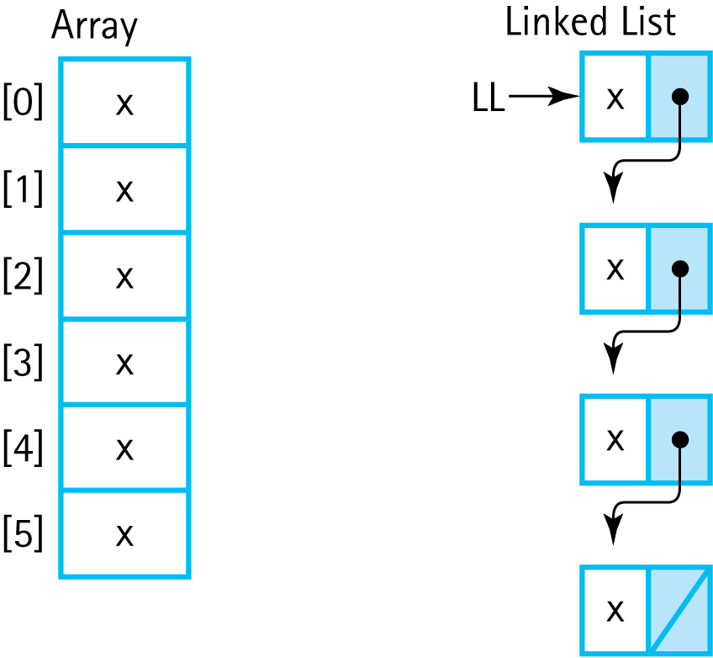
Array vs. Linked List
Figure 3.1 Comparison of Array and Linked Structure

Slide 9
Implementation: Constructors
Class Constructor: A special member function that is implicitly invoked when a class object is created
- Used to initialize objects and allocate resources
For UnsortedType, the constructor sets the length to 0
No resources need to be allocated because the size of the array is static

Slide 10
Class Constructor Rules
A constructor cannot return a function value and has no return value type
A class may have several constructors; the compiler chooses the appropriate constructor by the number and types of parameters used
Constructor parameters are placed in a parameter list in the declaration of the class object: SomeClass anObject(param1, param2);
The parameterless constructor is the default constructor
A class must have a default (parameterless) constructor in order to create arrays of that class

Slide 11
Implementation: Observers
IsFull and GetLength are straightforward
GetItem requires a linear search through the list
Use ItemType.CompareTo to check equality
Use bool &found reference parameter to indicate success to the user
Return a copy of the found item

Slide 12
Implementation: Transformers
PutItem: Insert item at the end of the list, increment length
DeleteItem: Linear search to find item, but how to remove it?
If the item is at the end of the list, just reduce the length of the list by one
But what about if it’s at the beginning?

Slide 13
Implementation: DeleteItem
Two strategies for removing an item in the middle of an array-based list:
Move Up: Move all items after the removed item up one position; this is inefficient for long lists
Swap: The list is unordered, so copy the item at the end of the list into the deleted item’s position

Slide 14
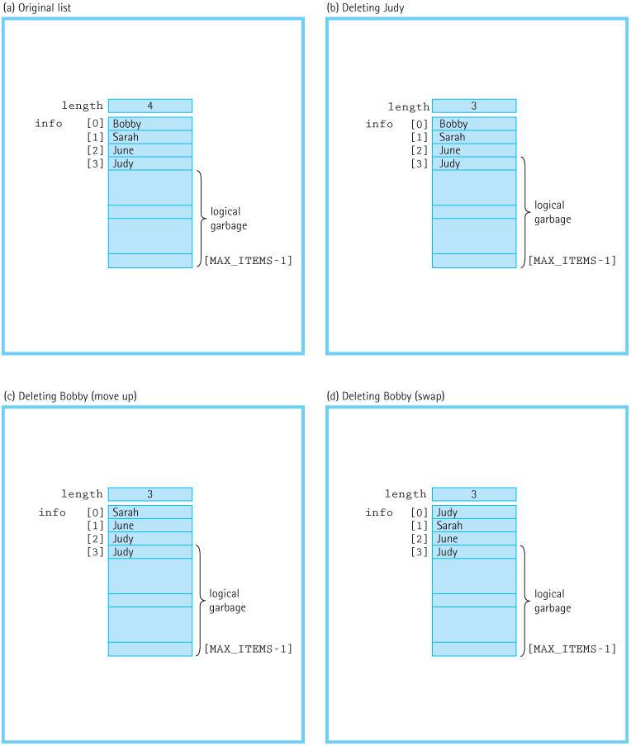
DeleteItem: Move or Swap?
Figure 3.4 Deleting an item in an unsorted list (a) Original list (b) Deleting Judy
(c) Deleting Bobby (move up) (d) Deleting Bobby (swap)

Slide 15
Implementation: Iterators
The field currentPos indicates the current position of iteration in the list
GetNextItem increments currentPos and returns the item at that position
ResetList must set currentPos to the first item’s predecessor
For arrays, that’s -1

Slide 16
Unsorted List: Test Plan
Preconditions and postconditions determine the black-box tests
Code of functions determines clear-box tests
We make sure the tests touch upon edge cases, such as the first and last items in the list, or a list with only one item

Slide 17
Pointer Types: Logical Level
A pointer variable contains the memory address of another variable
They are used for indirect addressing of data and for dynamic allocation of memory
Pointers are declared using an asterisk:
int* intPointer;

Slide 18
Pointer Operators
The prefix ampersand (&) or “address of” operator returns the address of a variable:
int alpha = 10;
intPointer = &alpha;
intPointer now contains alpha’s memory address
The asterisk dereference operator (*) denotes the variable to which a pointer points:
*intPointer = 25; // alpha is now 25

Slide 19
Dynamic Allocation
Dynamic Allocation: Allocation of memory space for a variable at run time, as opposed to static allocation at compile time
Dynamic allocation creates variables on the heap (or free store), a section of memory reserved for dynamic allocation

Slide 20
Dynamic Allocation (cont.)
Dynamic allocation uses the keyword new:
int* ptr = new int;
new returns a pointer to the newly allocated int on the heap, and the value can only be accessed via this pointer
Pointers can point to nothing using NULL
If no memory is available on the heap, new returns NULL

Slide 21
Memory Leak
A memory leak is the loss of available memory space that occurs when some dynamically allocated memory is never deallocated
Dynamically allocated memory that can’t be accessed is called garbage

Slide 22
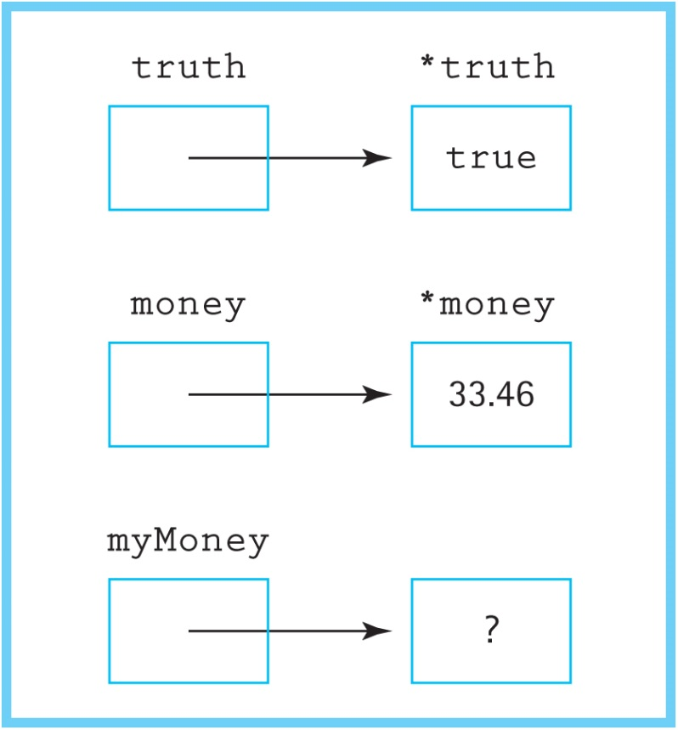
Memory Leak Example
float* money = new float;
*money = 33.46;
float* myMoney = new float;

Slide 23
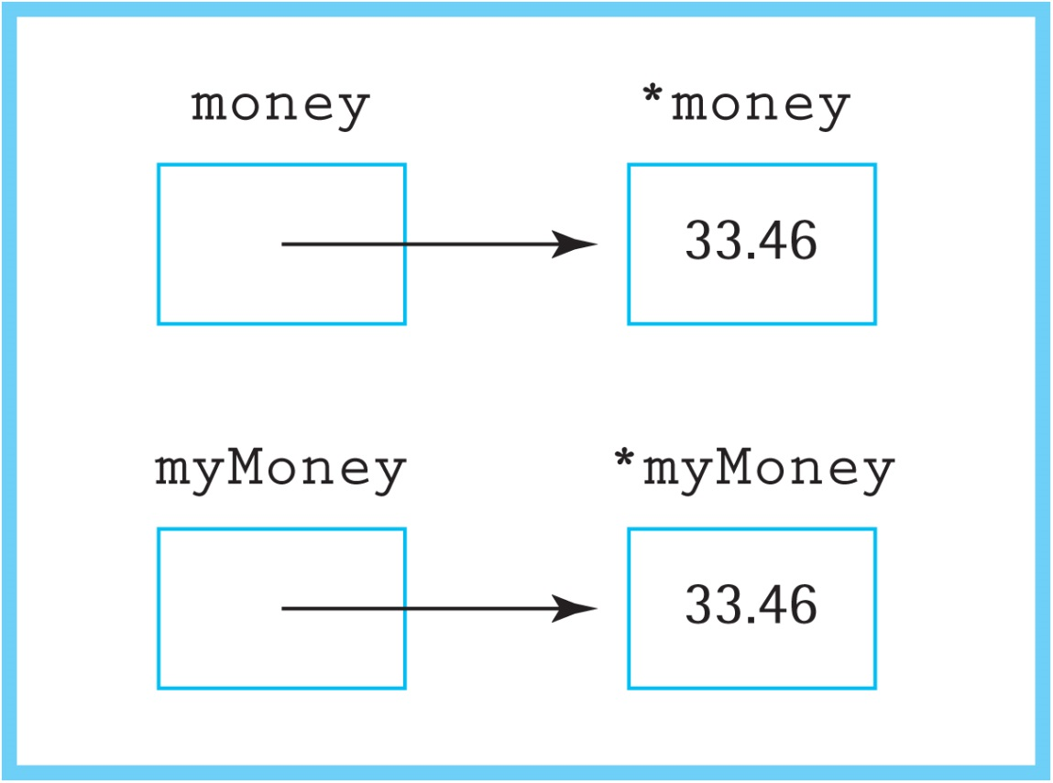
Memory Leak Example (cont.)
This copies the value pointed to by money into the memory pointed to by myMoney:
*myMoney = *money;

Slide 24
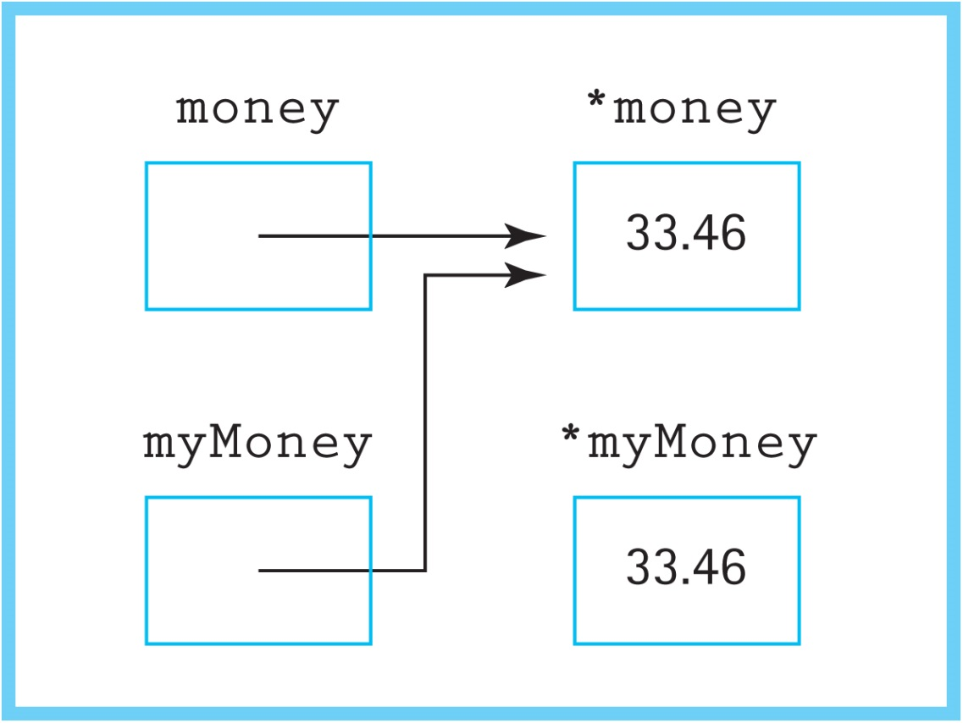
Memory Leak Example (cont.)
This makes myMoney point to the same address that money points to:
myMoney = money;

Slide 25
Memory Leak Example (cont.)
The memory cell originally used by myMoney is now inaccessible. Since there’s no way to collect the garbage, it is a small memory leak.

Slide 26
The Delete Operator
The delete operator deallocates the memory pointed to by the argument
Using delete myMoney would safely clean up the memory allocated to myMoney
C++ requires manual memory management

Slide 27
Pointers: Application Level
The name of an array variable when used without brackets is a pointer constant
Pointers can be used with constant types, allowing objects to link to each other
If myPtr is a pointer to an object, the fields of the object are accessed using the arrow operator: myPtr->field

Slide 28
Pointers: Implementation Level
Pointers and dynamic memory are thankfully handled entirely by the operating system, compiler, and run-time system
Except you must remember to delete dynamically allocated memory when you are finished with it!

Slide 29
UnsortedType as a Linked List
Linked List: A collection of nodes that are linked together in a chain using pointers
Node: The basic component of a linked list; stores data and a pointer to the next node
Nodes are created when needed using dynamically allocated memory
The last node in the list has a NULL pointer

Slide 30
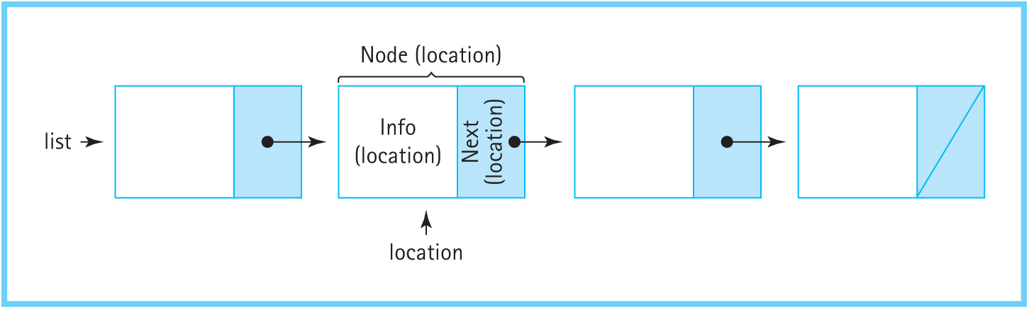
Nodes
Figure 3.11 Node Terminology

Slide 31
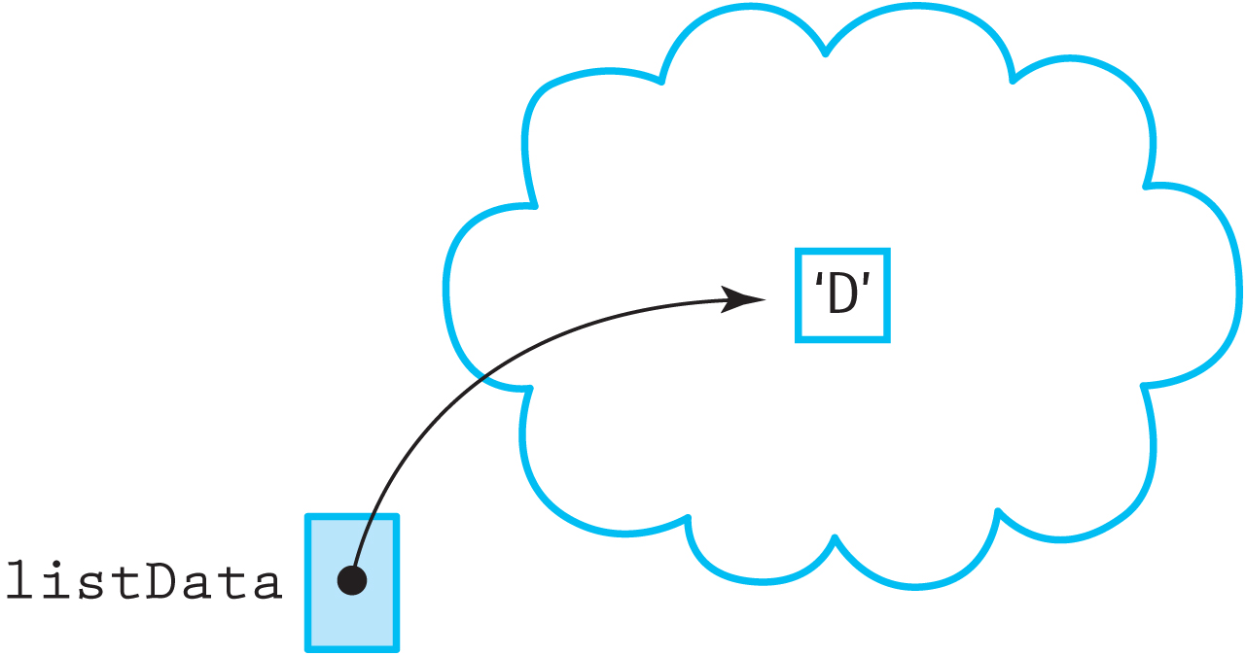
PutItem
When the list is empty, PutItem creates a node and sets the external pointer listData to it
Figure 3.9 Putting in the First Element

Slide 32
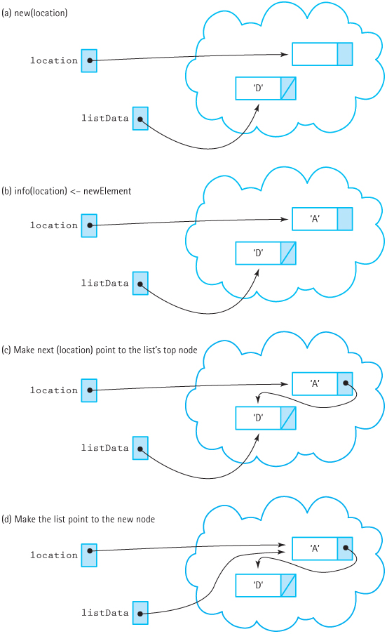
Building the Chain
Figure 3.12 The second PutItem operation (a) new(location) (b) info(location)
<- newElement (c) Make next (location) point to List's tope node (d) Make List
point to the new node

Slide 33
Length and Linked Lists
For array-based lists, the length field must be present in order to define the extent of the list within the array
Linked lists don’t have this restriction
Instead of a field, GetLength could walk the list and count the number of nodes

Slide 34
Iterators
The array-based implementation used currentPos, an array index
Linked lists use a pointer to a node instead
GetNextItem advances it: currentPos->next
ResetList sets it to NULL
GetNextItem checks if it’s NULL and sets it to the first item of the list

Slide 35
PutItem
Create a new node
Set the node’s info to the input data
Set the node’s next pointer to the listData, the first item in the list
Set listData to point to the new node
Order matters! Doing step 4 before step 3 would lead to a memory leak of the rest of the list.

Slide 36
PutItem (cont.)
void UnsortedType::PutItem (ItemType item)
// Pre: list is not full and item is not in list.
// Post: item is in the list; length has been incremented.
{
NodeType<ItemType>* location;
// create a new node and fill it
location = new NodeType<ItemType>;
location->info = item;
location->next = listData;
// the new node becomes head of the list
listData = location;
length++;
}

Slide 37
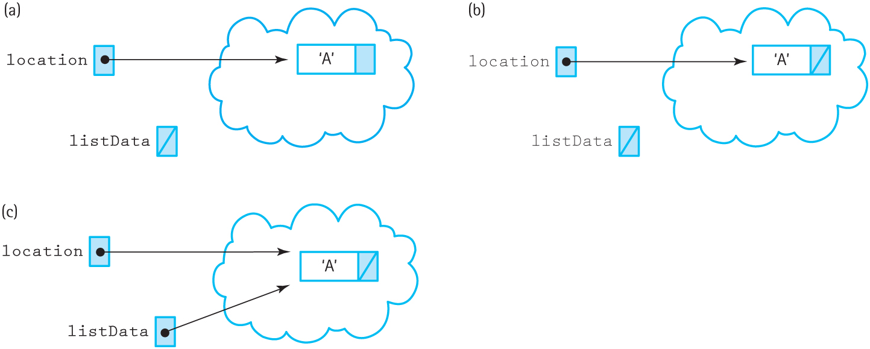
PutItem: Empty List
Figure 3.16 Putting an Item into an Empty List

Slide 38
Constructor
Largely unchanged
Set length to 0
Set the external pointer to NULL

Slide 39
IsFull
Linked lists don’t have an explicit size limit
New nodes can be allocated until there is no more memory to use
When this occurs, new will throw a bad_alloc exception
IsFull uses a try-catch block to allocate a node and returns true if a bad_alloc is thrown

Slide 40
IsFull (cont.)
bool UnsortedType::IsFull() const
// Returns true if there is no room for another ItemType
// on the free store; false otherwise.
{
NodeType* location;
try
{
location = new NodeType;
delete location;
return false;
}
catch(std::bad_alloc exception)
{
return true;
}
}

Slide 41
MakeEmpty
MakeEmpty must deallocate each node individually in order to empty the list
This is accomplished using a while loop
Iteration starts at listData, the head of the list, and continues using listData->next
Iteration stops when listData is NULL

Slide 42
GetItem
The algorithm is unchanged: Linear search through the list to find the desired item
In fact, the implementation is largely unchanged; it just needs to use pointers instead of array indices

Slide 43
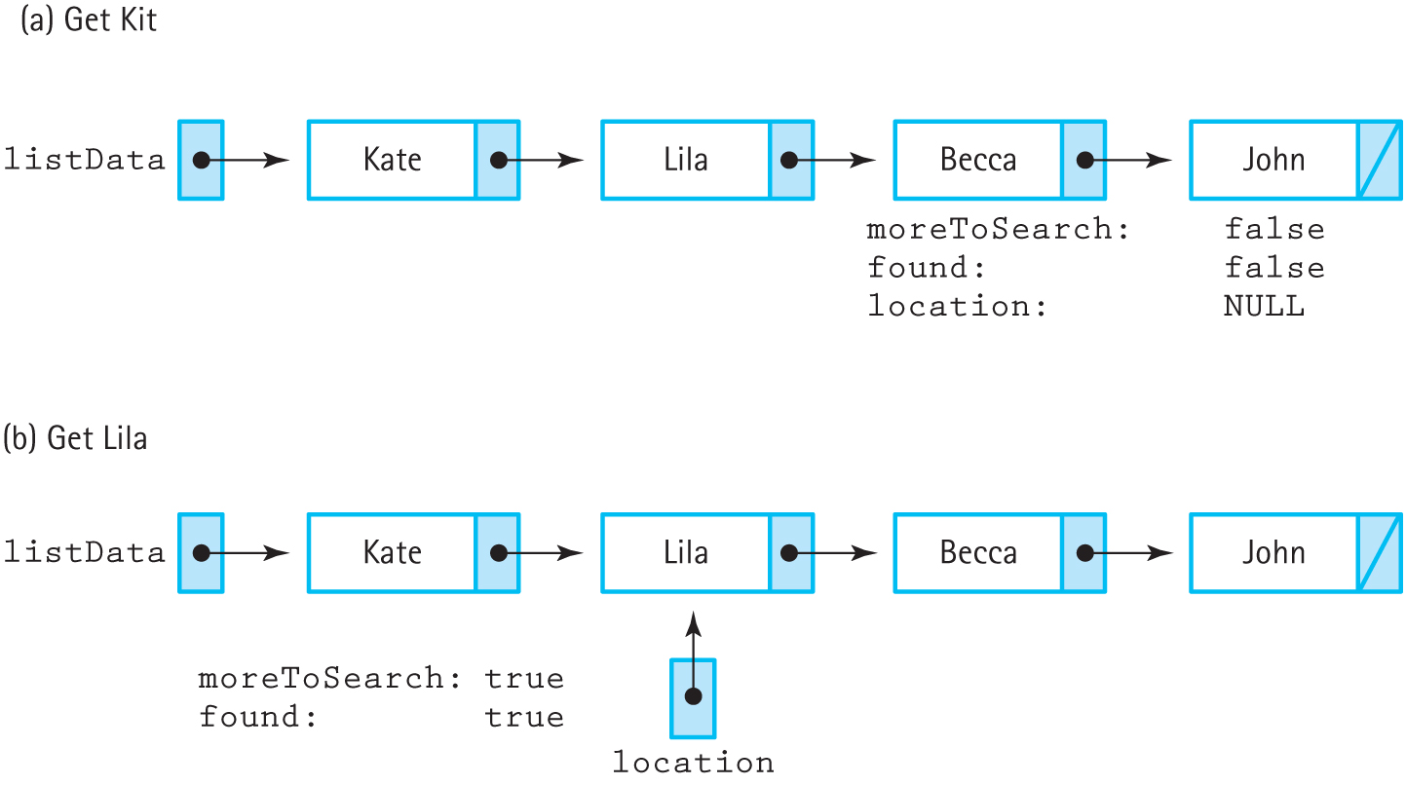
GetItem (cont.)
Figure 3.17 Retrieving an item in an unsorted linked list (a) Get Kit (b) Get Lila

Slide 44
DeleteItem
Deleting an item requires updating the pointer of its predecessor
Algorithm is the same, but search looks at the item of location->next in order to have access to the predecessor (location)

Slide 45
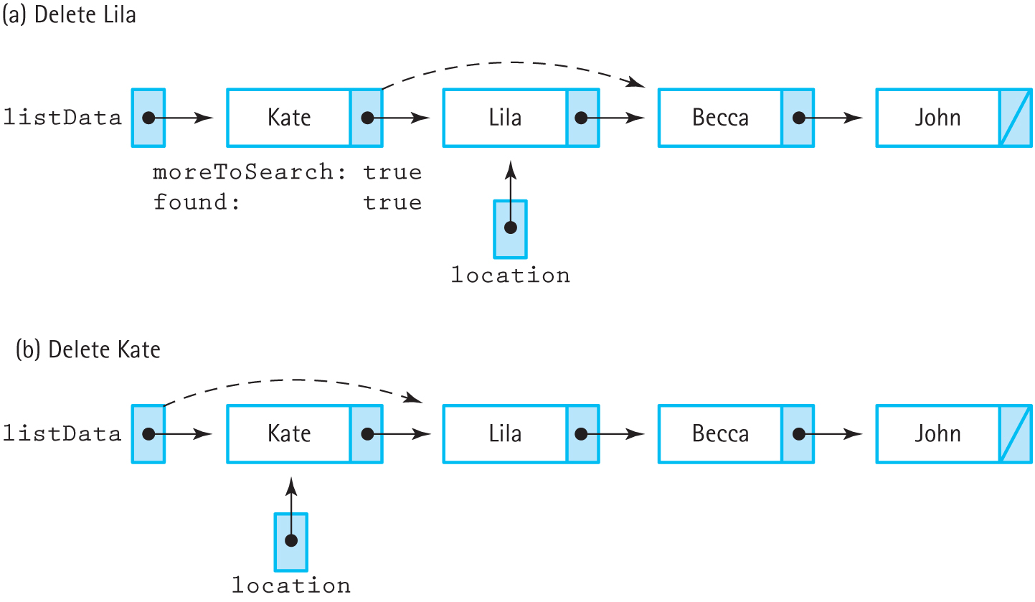
DeleteItem (cont.)
Figure 3.18 Deleting an interior node and deleting the first node (a) Delete Lila
(b) Delete Kate

Slide 46
Lifetime of a Variable
Lifetime: The time during execution that a variable has memory assigned to it
Global variable: The entire execution of a program
Local Variable: The execution of the block it is in
Dynamically allocated variable: From when it is allocated to when it is deallocated
The static keyword allows local variables to live outside the time of their blocks

Slide 47
Class Destructors
An object is deallocated when it leaves scope, but any data it points to is not – memory leak!
A class destructor is a method that is implicitly invoked when an object leave scope
The linked list destructor (~UnsortedList) must clean up the object’s memory by deallocating all the nodes in the list

Slide 48
Comparing Implementations
The array-based list allocates enough memory for the max list size, no matter how many items are actually in the list
The linked list-based list only uses enough memory for the items in the list
Both have operations that are O(1)
Linked list’s MakeEmpty is O(N)

Slide 49
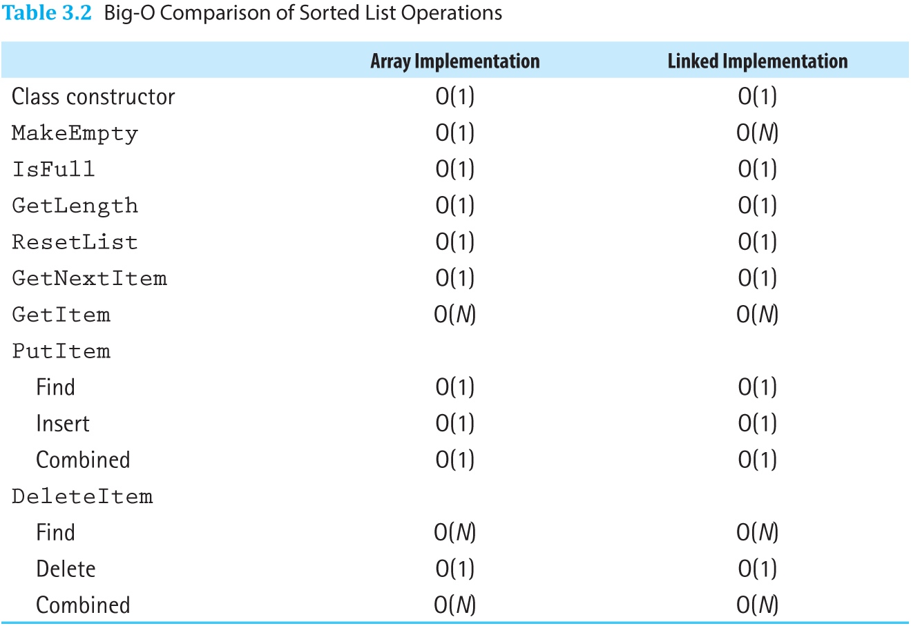
Comparing Implementations (cont.)
Table 3.2 Big-O Comparison of Sorted List Operations

